Slide 1

A Case for Statutory Reasoning
Benjamin Van Durme

Slide 2



Collaborators
Soon on the market
worksFor
Andrew Blair-Stanek
studentOf
Nils Holzenberger

Slide 3
Natural legal language processing
Conferences and workshops: NLLP workshop, ICAIL, JURIX
Research topics:
- Legal judgment prediction/Case outcome prediction
- Modeling legal rules and contracts with expert systems
- Semantic parsing of legal language
- Question answering (eg bar exam questions)
- Tagging and classification
- Information extraction

Slide 4
My salient background
1999 Considered grad programs for “AI and Law” ...
2003 Partially completed applications to law school …
2005 Brief startup on legal discovery …
… did various things in computational semantics …
2019 Local professor at law school interviews for CS PhD program

Slide 5
I want to use computers to find loopholes in tax law proposals
What do you want to do in your PhD?
Benjamin Van Durme
Cool
Very cool
Andrew Blair-Stanek
Nils Holzenberger

Slide 6
What is statutory reasoning?
Policies, laws, rules, describe what is true
Given a case, one must decide whether and how those rules apply
Sometimes there are enough similar cases to reason from
This can literally be called “case-based reasoning”

Slide 7
What if there are no previous cases?
If you think about semantics, this is the cool part!
For some domains, such as US Federal Tax Law, the number of publicly-decided consequential cases each year may be limited
E.g., large multinational corporations may not often settle in public
But policies may change as a result of consequential cases (closing loopholes)
So: no large collection of static policy + previous decided cases to memorize!

Slide 8
If there are no examples then …?
You have to build systems that actually understand the statutory language!
We may have previous versions of the law, and limited cases that were decided under that version
We need to learn:
how to break down complex systems of rules,
how to reason with them for a provided case, and
how to generalize to rules not seen at training time

Slide 9
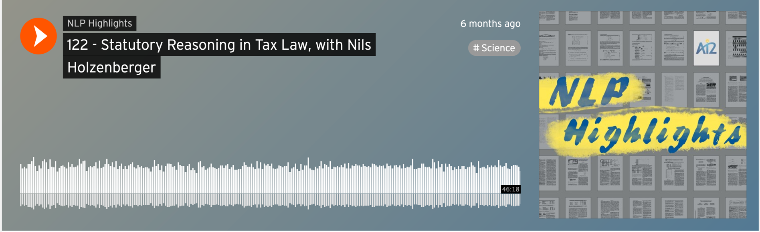
For discussion outside this talk
Featured on AI2’s NLP Highlights podcast
https://soundcloud.com/nlp-highlights/122-statutory-reasoning-in-tax-law-with-nils-holzenberger

Slide 10
In the rest of this talk …
I will discuss iterations on formulating computational statutory reasoning

Slide 11
A Dataset for Statutory Reasoning in Tax Law Entailment and Question Answering
Natural Legal Language Processing (NLLP) Workshop @ KDD 2020
Andrew Blair-Stanek
Nils Holzenberger

Slide 12
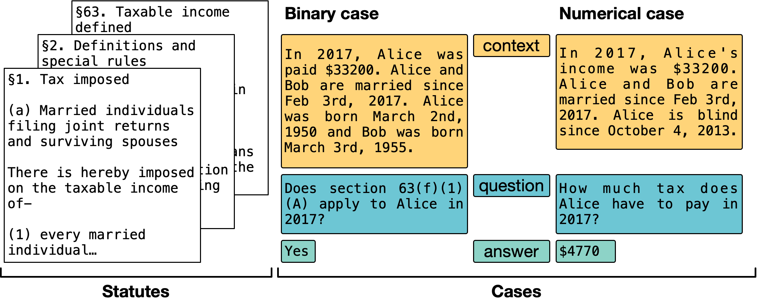
Statutory Reasoning Assessment (SARA)
Manually select and abbreviate 9 sections of federal tax law
Author 376 synthetic cases covering each subsection and tax computation
Tax law professor vets each case and statute interpretation

Slide 13
Features of SARA
§1. Tax imposed
(a) Married individuals filing joint returns and surviving spouses
There is hereby imposed on the taxable income of-
(1) every married individual (as defined in section 7703) who makes a single return jointly with his spouse, and
(2) every surviving spouse (as defined in section 2(a)),
a tax determined in accordance with the following:
(i) 15% of taxable income if the taxable income is not over $36,900;
(ii) $5,535, plus 28% of the excess over $36,900 if the taxable income is over $36,900 but not over $89,150;
(iii) $20,165, plus 31% of the excess over $89,150 if the taxable income is over $89,150 but not over $140,000; ….
How much tax do I owe?

Slide 14
Features of SARA
§1. Tax imposed
(a) Married individuals filing joint returns and surviving spouses
There is hereby imposed on the taxable income of-
(1) every married individual (as defined in section 7703) who makes a single return jointly with his spouse, and
(2) every surviving spouse (as defined in section 2(a)),
a tax determined in accordance with the following:
(i) 15% of taxable income if the taxable income is not over $36,900;
(ii) $5,535, plus 28% of the excess over $36,900 if the taxable income is over $36,900 but not over $89,150;
(iii) $20,165, plus 31% of the excess over $89,150 if the taxable income is over $89,150 but not over $140,000; ….
Hierarchical structure

Slide 15
Features of SARA
§1. Tax imposed
(a) Married individuals filing joint returns and surviving spouses
There is hereby imposed on the taxable income of-
(1) every married individual (as defined in section 7703) who makes a single return jointly with his spouse, and
(2) every surviving spouse (as defined in section 2(a)),
a tax determined in accordance with the following:
(i) 15% of taxable income if the taxable income is not over $36,900;
(ii) $5,535, plus 28% of the excess over $36,900 if the taxable income is over $36,900 but not over $89,150;
(iii) $20,165, plus 31% of the excess over $89,150 if the taxable income is over $89,150 but not over $140,000; ….
Hierarchical structure

Slide 16
Features of SARA
§1. Tax imposed
(a) Married individuals filing joint returns and surviving spouses
There is hereby imposed on the taxable income of-
(1) every married individual (as defined in section 7703) who makes a single return jointly with his spouse, and
(2) every surviving spouse (as defined in section 2(a)),
a tax determined in accordance with the following:
(i) 15% of taxable income if the taxable income is not over $36,900;
(ii) $5,535, plus 28% of the excess over $36,900 if the taxable income is over $36,900 but not over $89,150;
(iii) $20,165, plus 31% of the excess over $89,150 if the taxable income is over $89,150 but not over $140,000; ….
Hierarchical structure
Numerical reasoning

Slide 17
Features of SARA
§1. Tax imposed
(a) Married individuals filing joint returns and surviving spouses
There is hereby imposed on the taxable income of-
(1) every married individual (as defined in section 7703) who makes a single return jointly with his spouse, and
(2) every surviving spouse (as defined in section 2(a)),
a tax determined in accordance with the following:
(i) 15% of taxable income if the taxable income is not over $36,900;
(ii) $5,535, plus 28% of the excess over $36,900 if the taxable income is over $36,900 but not over $89,150;
(iii) $20,165, plus 31% of the excess over $89,150 if the taxable income is over $89,150 but not over $140,000; ….
Hierarchical structure
Numerical reasoning

Slide 18
Features of SARA
§1. Tax imposed
(a) Married individuals filing joint returns and surviving spouses
There is hereby imposed on the taxable income of-
(1) every married individual (as defined in section 7703) who makes a single return jointly with his spouse, and
(2) every surviving spouse (as defined in section 2(a)),
a tax determined in accordance with the following:
(i) 15% of taxable income if the taxable income is not over $36,900;
(ii) $5,535, plus 28% of the excess over $36,900 if the taxable income is over $36,900 but not over $89,150;
(iii) $20,165, plus 31% of the excess over $89,150 if the taxable income is over $89,150 but not over $140,000; ….
Hierarchical structure
Numerical reasoning
Cross-references

Slide 19
Features of SARA
§1. Tax imposed
(a) Married individuals filing joint returns and surviving spouses
There is hereby imposed on the taxable income of-
(1) every married individual (as defined in section 7703) who makes a single return jointly with his spouse, and
(2) every surviving spouse (as defined in section 2(a)),
a tax determined in accordance with the following:
(i) 15% of taxable income if the taxable income is not over $36,900;
(ii) $5,535, plus 28% of the excess over $36,900 if the taxable income is over $36,900 but not over $89,150;
(iii) $20,165, plus 31% of the excess over $89,150 if the taxable income is over $89,150 but not over $140,000; ….
Hierarchical structure
Numerical reasoning
Cross-references
implicit (§63)
explicit

Slide 20
Features of SARA
§2. Definitions and special rules
(a) Definition of surviving spouse
(1) In general
For purposes of section 1, the term "surviving spouse" means a taxpayer-
(A) whose spouse died during either of the two years immediately preceding the taxable year, and
(B) who maintains as his home a household which constitutes for the taxable year the principal place of abode (as a member of such household) of a dependent
(i) who (within the meaning of section 152) is a son, stepson, daughter, or stepdaughter of the taxpayer, and (ii) with respect to whom the taxpayer is entitled to a deduction for the taxable year under section 151.
Hierarchical structure
Numerical reasoning
Cross-references

Slide 21
Features of SARA
§2. Definitions and special rules
(a) Definition of surviving spouse
(1) In general
For purposes of section 1, the term "surviving spouse" means a taxpayer-
(A) whose spouse died during either of the two years immediately preceding the taxable year, and
(B) who maintains as his home a household which constitutes for the taxable year the principal place of abode (as a member of such household) of a dependent
(i) who (within the meaning of section 152) is a son, stepson, daughter, or stepdaughter of the taxpayer, and (ii) with respect to whom the taxpayer is entitled to a deduction for the taxable year under section 151.
Hierarchical structure
Numerical reasoning
Cross-references
Common sense

Slide 22
Features of SARA
§2. Definitions and special rules
(a) Definition of surviving spouse
(1) In general
For purposes of section 1, the term "surviving spouse" means a taxpayer-
(A) whose spouse died during either of the two years immediately preceding the taxable year, and
(B) who maintains as his home a household which constitutes for the taxable year the principal place of abode (as a member of such household) of a dependent
(i) who (within the meaning of section 152) is a son, stepson, daughter, or stepdaughter of the taxpayer, and (ii) with respect to whom the taxpayer is entitled to a deduction for the taxable year under section 151.
Hierarchical structure
Numerical reasoning
Cross-references
Common sense

Slide 23
Features of SARA
§2. Definitions and special rules
(a) Definition of surviving spouse
(1) In general
For purposes of section 1, the term "surviving spouse" means a taxpayer-
(A) whose spouse died during either of the two years immediately preceding the taxable year, and
(B) who maintains as his home a household which constitutes for the taxable year the principal place of abode (as a member of such household) of a dependent
[…]
For purposes of this paragraph, an individual shall be considered as maintaining a household only if over half of the cost of maintaining the household during the taxable year is furnished by such individual.
Hierarchical structure
Numerical reasoning
Cross-references
Common sense

Slide 24
Features of SARA
§2. Definitions and special rules
(a) Definition of surviving spouse
(1) In general
For purposes of section 1, the term "surviving spouse" means a taxpayer-
(A) whose spouse died during either of the two years immediately preceding the taxable year, and
(B) who maintains as his home a household which constitutes for the taxable year the principal place of abode (as a member of such household) of a dependent
[…]
For purposes of this paragraph, an individual shall be considered as maintaining a household only if over half of the cost of maintaining the household during the taxable year is furnished by such individual.
Hierarchical structure
Numerical reasoning
Cross-references
Common sense
Temporal reasoning

Slide 25
Features of SARA
§2. Definitions and special rules
(a) Definition of surviving spouse
[...]
(2) Limitations
Notwithstanding paragraph (1), for purposes of section 1 a taxpayer shall not be considered to be a surviving spouse-
(A) if the taxpayer has remarried at any time before the close of the taxable year, or
(B) unless, for the taxpayer's taxable year during which his spouse died, a joint return could have been made. A husband and wife may make a single return jointly of income taxes, even though one of the spouses has neither gross income nor deductions, except that no joint return shall be made if either the husband or wife at any time during the taxable year is a nonresident alien.
Hierarchical structure
Numerical reasoning
Cross-references
Common sense
Temporal reasoning

Slide 26
Features of SARA
§2. Definitions and special rules
(a) Definition of surviving spouse
[...]
(2) Limitations
Notwithstanding paragraph (1), for purposes of section 1 a taxpayer shall not be considered to be a surviving spouse-
(A) if the taxpayer has remarried at any time before the close of the taxable year, or
(B) unless, for the taxpayer's taxable year during which his spouse died, a joint return could have been made. A husband and wife may make a single return jointly of income taxes, even though one of the spouses has neither gross income nor deductions, except that no joint return shall be made if either the husband or wife at any time during the taxable year is a nonresident alien.
Hierarchical structure
Numerical reasoning
Cross-references
Common sense
Temporal reasoning
Exceptions and substitutions

Slide 27
Features of SARA
§2. Definitions and special rules
[...]
(b) Definition of head of household
[...]
(3) Limitations
Notwithstanding paragraph (1), for purposes of this subtitle a taxpayer shall not be considered to be a head of a household-
(A) if at any time during the taxable year he is a nonresident alien; or
(B) by reason of an individual who would not be a dependent for the taxable year but for subparagraph (H) of section 152(d)(2).
Hierarchical structure
Numerical reasoning
Cross-references
Common sense
Temporal reasoning
Exceptions and substitutions

Slide 28
Features of SARA
§2. Definitions and special rules
[...]
(b) Definition of head of household
[...]
(3) Limitations
Notwithstanding paragraph (1), for purposes of this subtitle a taxpayer shall not be considered to be a head of a household-
(A) if at any time during the taxable year he is a nonresident alien; or
(B) by reason of an individual who would not be a dependent for the taxable year but for subparagraph (H) of section 152(d)(2).
Hierarchical structure
Numerical reasoning
Cross-references
Common sense
Temporal reasoning
Exceptions and substitutions
(Some) conditional counterfactuals

Slide 29
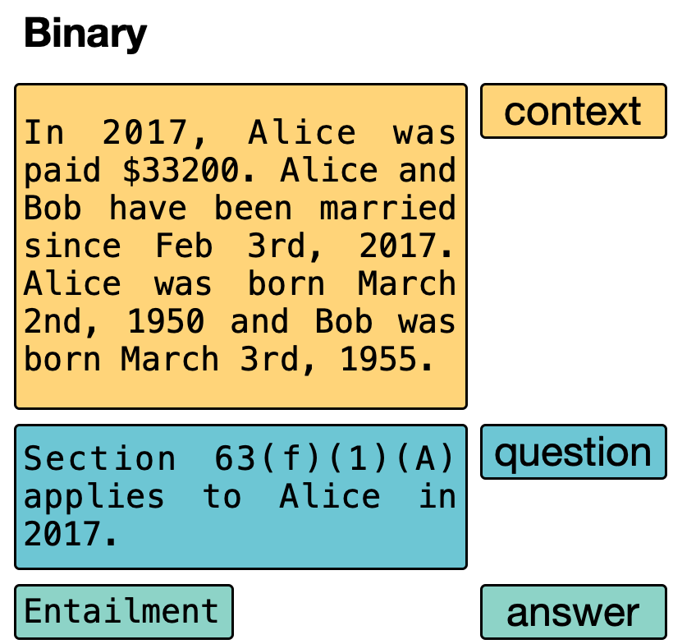
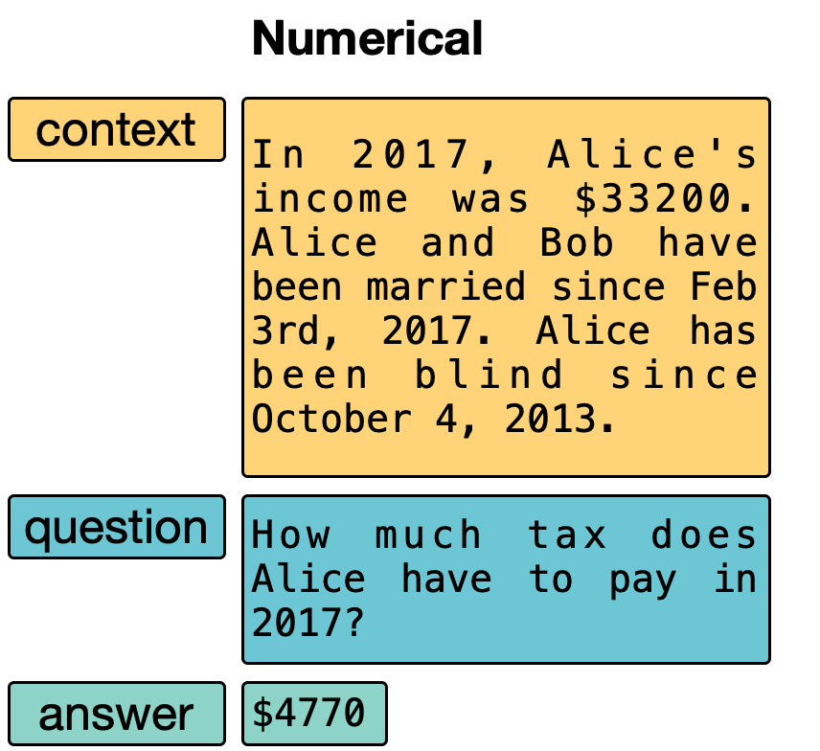
Statutory Reasoning Assessment

Slide 30
This is hard!
SARA is designed to require natural language understanding and logical reasoning
To verify the task is solvable, we provide a mapping to Prolog:
Each statue is manually translated into a set of predicates
Facts of case translated to a knowledge graph

Slide 31
Translating statutes
“(b) Heads of households
There is hereby imposed on the taxable income of every head of a household (as defined in section 2(b)) a tax determined in accordance with the following:
(i) 15% of taxable income if the taxable income is not over $29,600;
(ii) $4,440, plus 28% of the excess over $29,600 if the taxable income is over $29,600 but not over $76,400;
(iii) $17,544, plus 31% of the excess over $76,400 if the taxable income is over $76,400 but not over $127,500;
...”
s1_b(Taxp, Taxy, Taxinc, Tax) :-
s2_b(Taxp, _, Taxy),
s63(Taxp, Taxy, Taxinc),
(
s1_b_i(Taxinc, Tax);
s1_b_ii(Taxinc, Tax);
s1_b_iii(Taxinc, Tax);
s1_b_iv(Taxinc, Tax);
s1_b_v(Taxinc, Tax)
).

Slide 32
Translating facts of a case
“Bob and Alice got married on August 24th, 1970”
marriage_(alice_and_bob).
agent_(alice_and_bob, alice).
agent_(alice_and_bob, bob).
start_(alice_and_bob, “1970-08-24”).

Slide 33
Can we automatically solve SARA?
Prolog solver is, by design, achieves 100% accuracy on the task
(Spoiler) Off the shelf ML solutions perform near chance
SARA is purposefully sparse
Recent agenda: adapt and extend contemporary approaches to SARA, assess what works (even a little), to inform new solutions

Slide 34
Machine Reading/Language Models
Adapt Recognizing Textual Entailment models?

Slide 35
Machine Reading/Language Models
Supervised Regression?
Seeking to predict Substantial over/understatement of tax §6662(d)

Slide 36
Machine Reading/Language Models
Effectively at chance

Slide 37
Training domain specific encoders, e.g., LegalBERT

Slide 38


LegalBERT
Step 1: Preprocess case.law

Slide 39
LegalBERT
Step 1: Preprocess case.law
Step 2: Continued training of BERT Base Cased
Cases starting in 1970
400+ tokens per case
900,000,000 tokens in total

Slide 40
LegalBERT
Step 1: Preprocess case.law
Step 2: Continued training of BERT Base Cased
Step 3: Evaluate on legal term discovery
Purchase, scan, OCR legal dictionary
Define ‘legal term’ recognitions as B-I-O sequence tagging
Results: better than lawyers, LegalBERT > BERT

Slide 41
LegalBERT
Step 1: Preprocess case.law
Step 2: Continued training of BERT Base Cased
Step 3: Evaluate on legal term discovery
Step 4: Measure on SARA examples

Slide 42
Machine Reading/Language Models
Domain specific features barely help

Slide 43
Statutory reasoning?
Manual NLU + Prolog solver is sufficient
Off the shelf and domain adapted machine reading models struggle
Ablation experiments suggest that statutes are being ignored
What to do?
Semantic parsing for legal texts?
New science in efficiently creating a lot more data?
New science in machine reading to be far more data efficient?
Breaking the task into smaller parts?

Slide 44

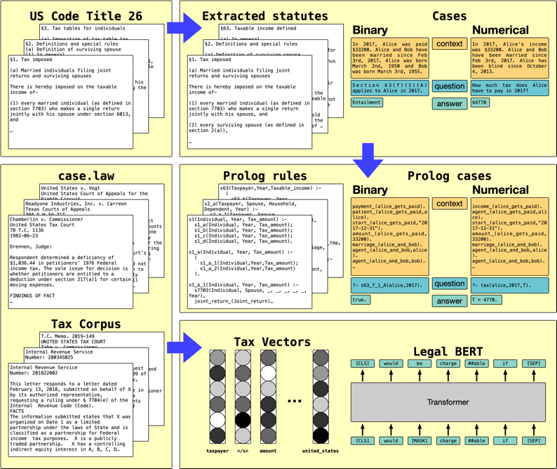
Factoring Statutory Reasoning as Language Understanding Challenges
ACL 2021
Nils Holzenberger
Resources posted to https://nlp.jhu.edu/law/

Slide 45
Factoring Statutory Reasoning
Rather than “language in, answer out” model, let’s break into subparts:
Argument (entity mention) identification within statutes
Argument coreference within statutes
Conversion of statutes into structured neural module networks
Instantiating statutes with arguments from case
Semantic Parsing
Legal Information Extraction
Machine Reading

Slide 46
Argument Identification
For purposes of this chapter, the term "employment" means any service, of whatever nature,
(A) performed by an employee for the person employing him, irrespective of the citizenship or residence of either, within the United States, and
(B) performed outside the United States (except in a contiguous country with which the United States has an agreement relating to unemployment compensation) by a citizen of the United States as an employee of an American employer, except- […]
Concrete references
Case-specific values

Slide 47
Argument identification baselines

Slide 48
Argument coreference

Slide 49
Argument coreference baselines
Single mention: predict no coreference links
String matching: strings are identical (excepting determiners)

Slide 50
Combined argument identification and coreference
BERT-based argument identification with string-matching coreference
Perfectly resolves ~20% of subsections

Slide 51


(ongoing work: legal coreference)
Statutes and cases quite different than newswire, discussion forums, or books (LitBank)
Hopefully a fun new task for coreference researchers
Documents can be quite long…
Patrick Xia
Nils Holzenberger
Andrew Blair-Stanek

Slide 52
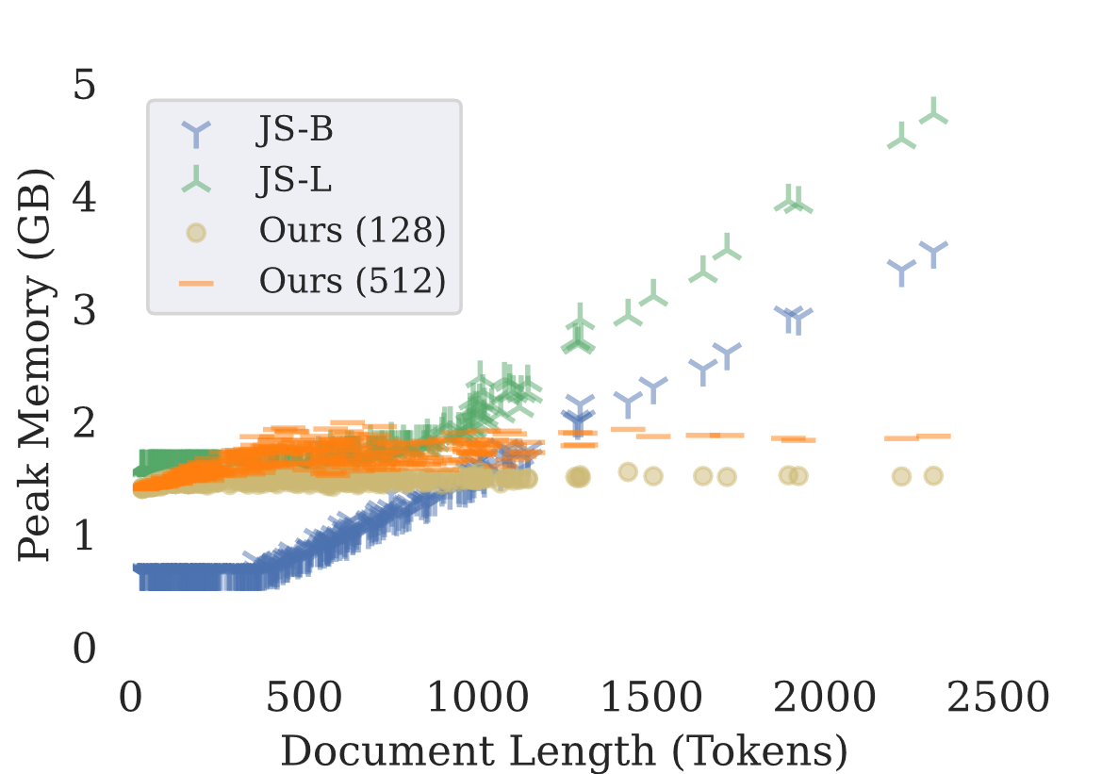

Building on: Incremental Neural Coreference Resolution in Constant Memory
EMNLP 2020
Patrick Xia
Standard Models
This work
João Sedoc
Notes:
Hi, I’m Patrick and I’ll present this work with Joao Sedoc and Benjamin Van Durme on Constant Memory Coreference Resolution.

Slide 53
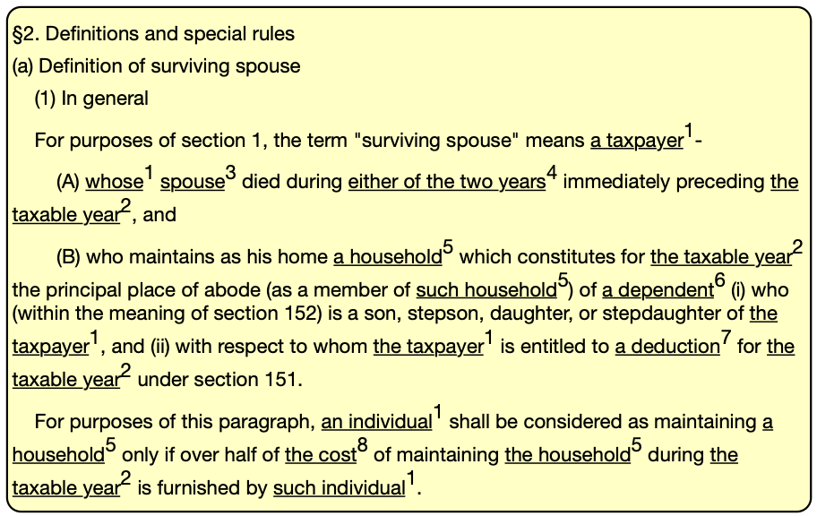
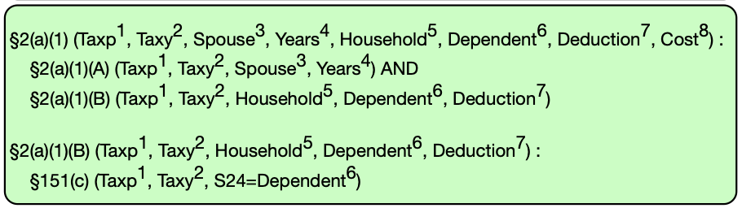
Statutes to structures
How to tie discovered arguments into structured modules for inference?
We assume the Prolog structures, as if a tech-savvy Congress provided machine readable versions of policy
Future work: semantic parsing for statutes

Slide 54
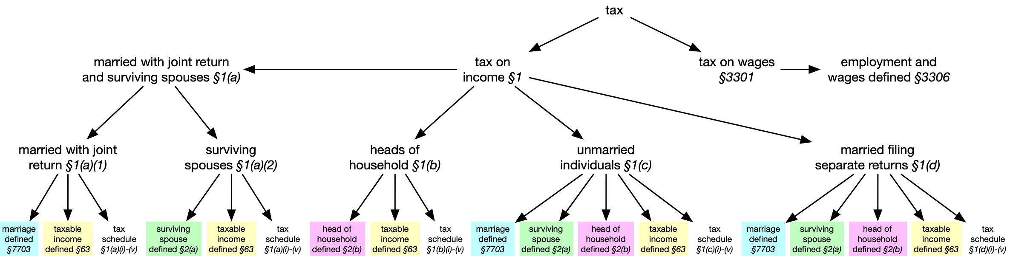
Structure extraction

Slide 55
Argument Instantiation
Given structured statutes, how to apply to a case?
We extend our prior work:
Reading the Manual: Event Extraction as Definition Comprehension
EMNLP 2020 Workshop on Structured Prediction for NLP
Yunmo Chen, Tongfei Chen, Seth Ebner, Aaron Steven White, Van Durme

Slide 56
Definition comprehension
“A Life:DIE Event occurs whenever the life of a PERSON Entity ends. DIE Events can be accidental, intentional or self-inflicted.”
Semantically bleached statements

Slide 57
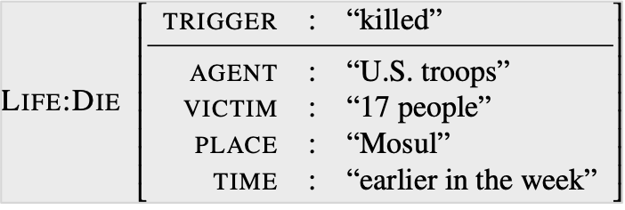
Unrest continued in other parts of the country. Americans sought to bring calm to Mosul, where U.S. troops killed 17 people in clashes earlier in the week. …

Slide 58
Unrest continued in other parts of the country. Americans sought to bring calm to Mosul, where U.S. troops killed 17 people in clashes earlier in the week. …

Slide 59
Unrest continued in other parts of the country. Americans sought to bring calm to Mosul, where U.S. troops killed 17 people in clashes earlier in the week. …
U.S. troops

Slide 60
Unrest continued in other parts of the country. Americans sought to bring calm to Mosul, where U.S. troops killed 17 people in clashes earlier in the week. …
U.S. troops

Slide 61
Unrest continued in other parts of the country. Americans sought to bring calm to Mosul, where U.S. troops killed 17 people in clashes earlier in the week. …
U.S. troops
17 people

Slide 62
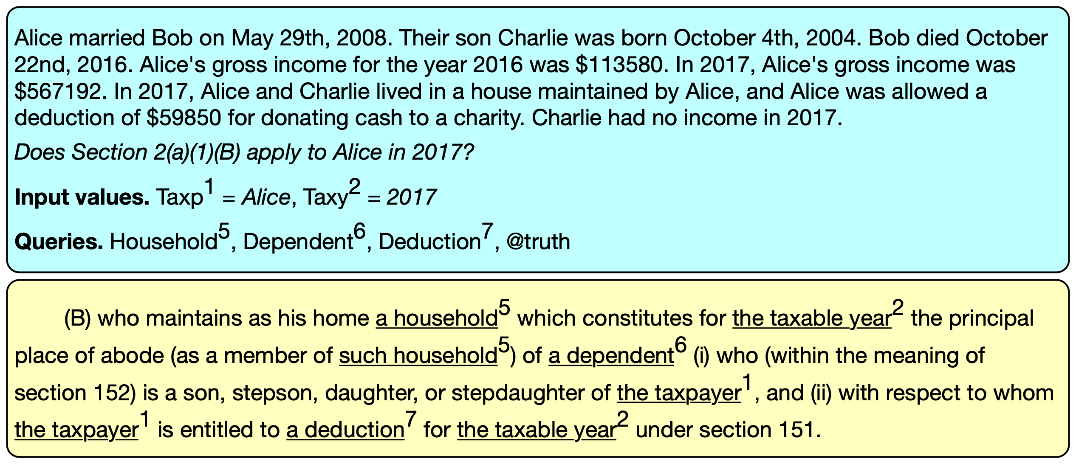
Argument instantiation — machine reading

Slide 63
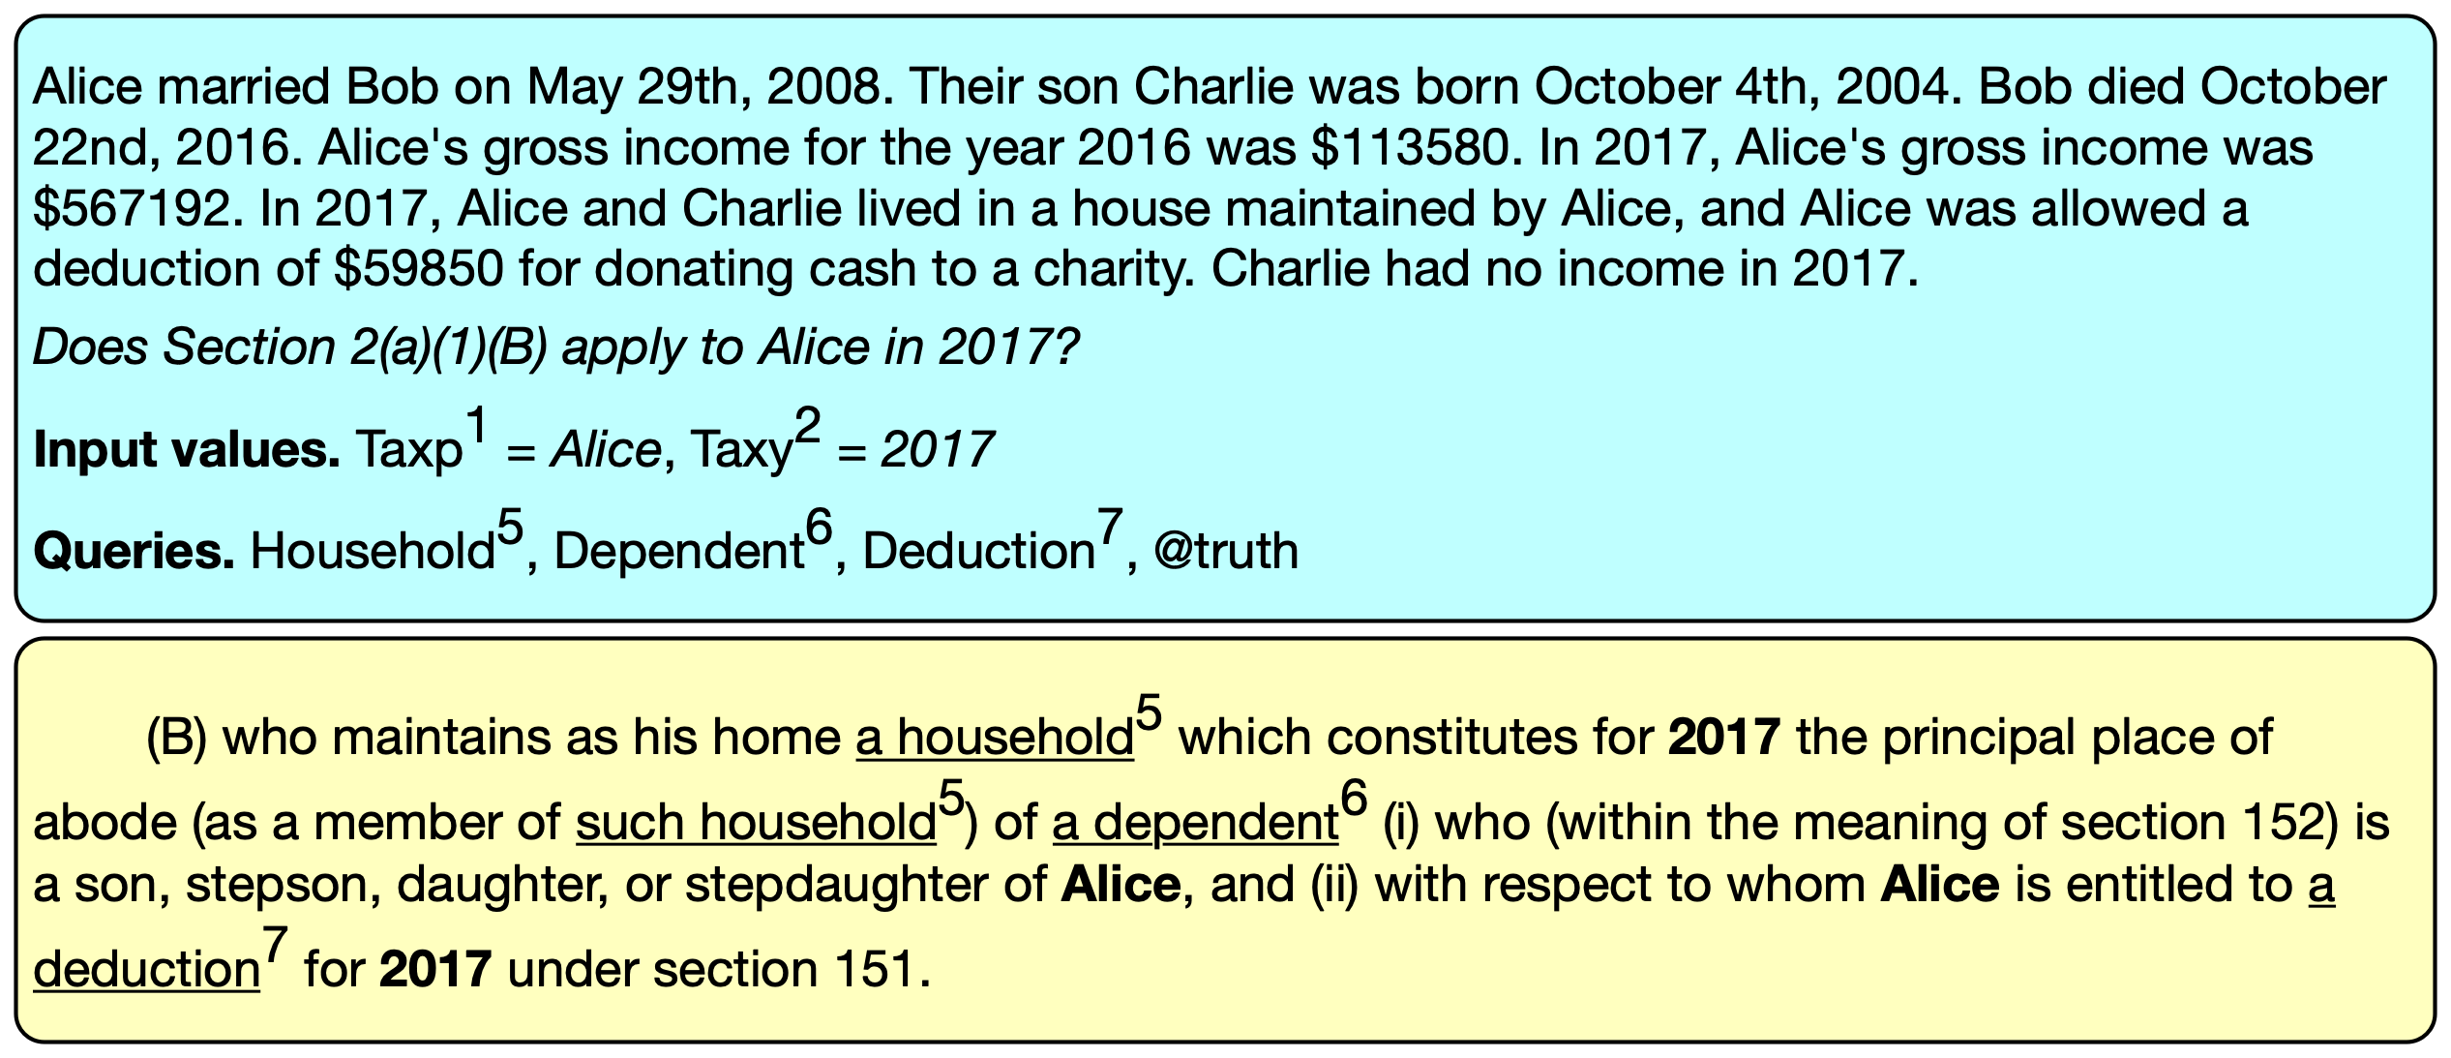
Argument instantiation — machine reading

Slide 64
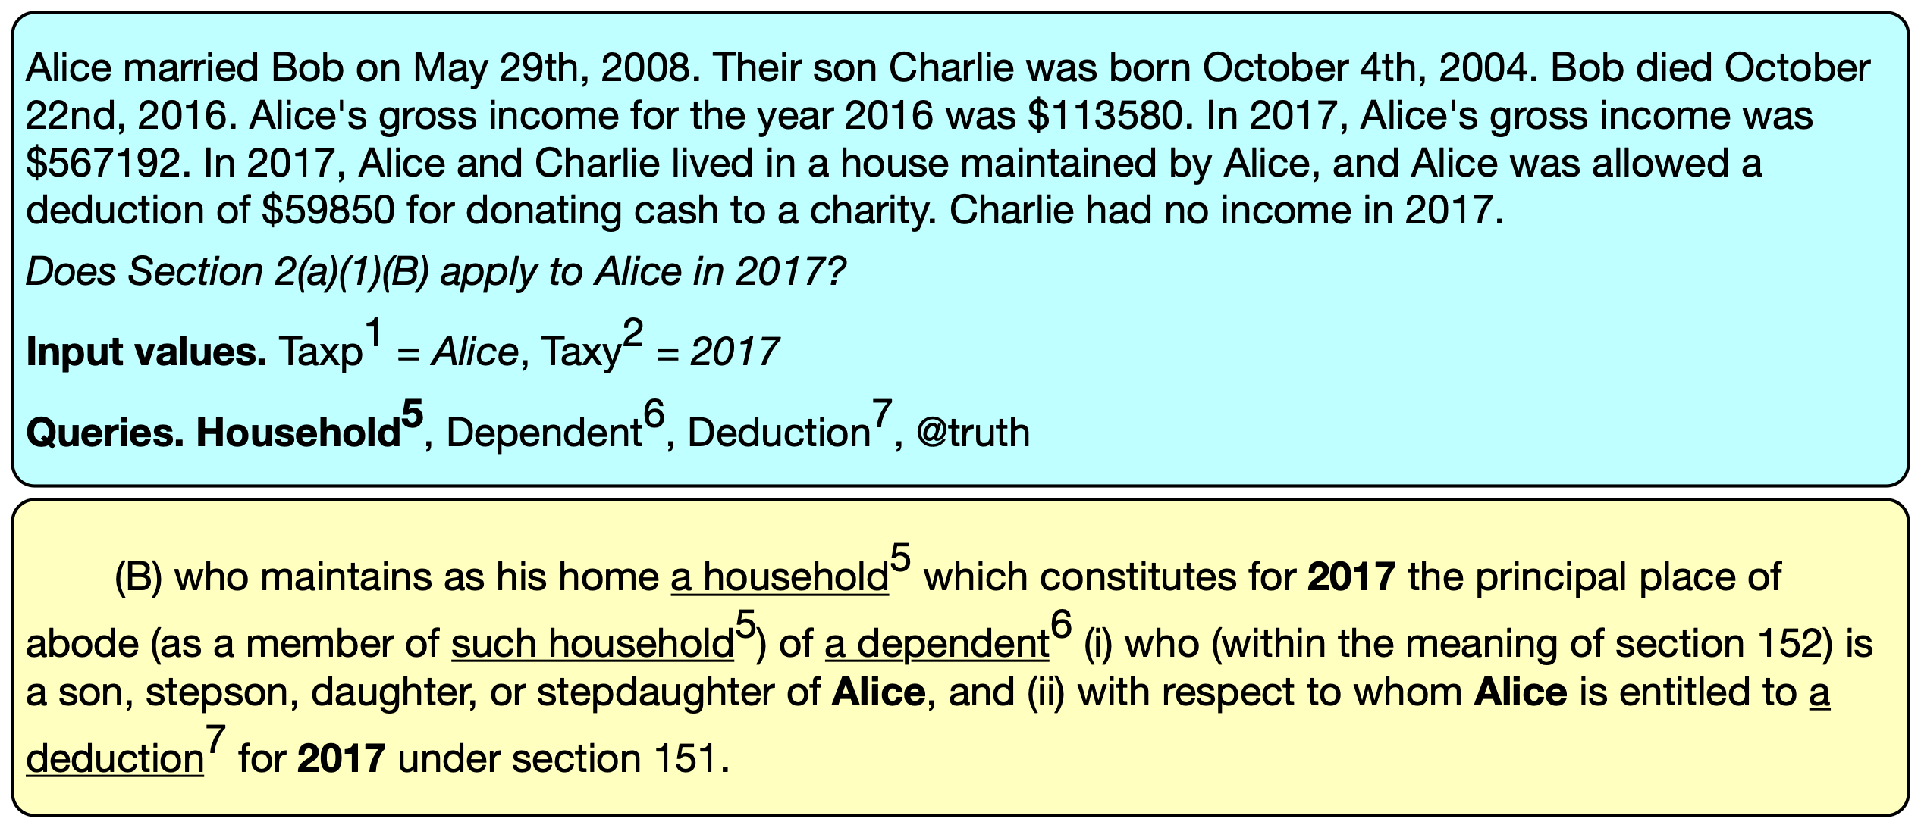
Argument instantiation — machine reading

Slide 65
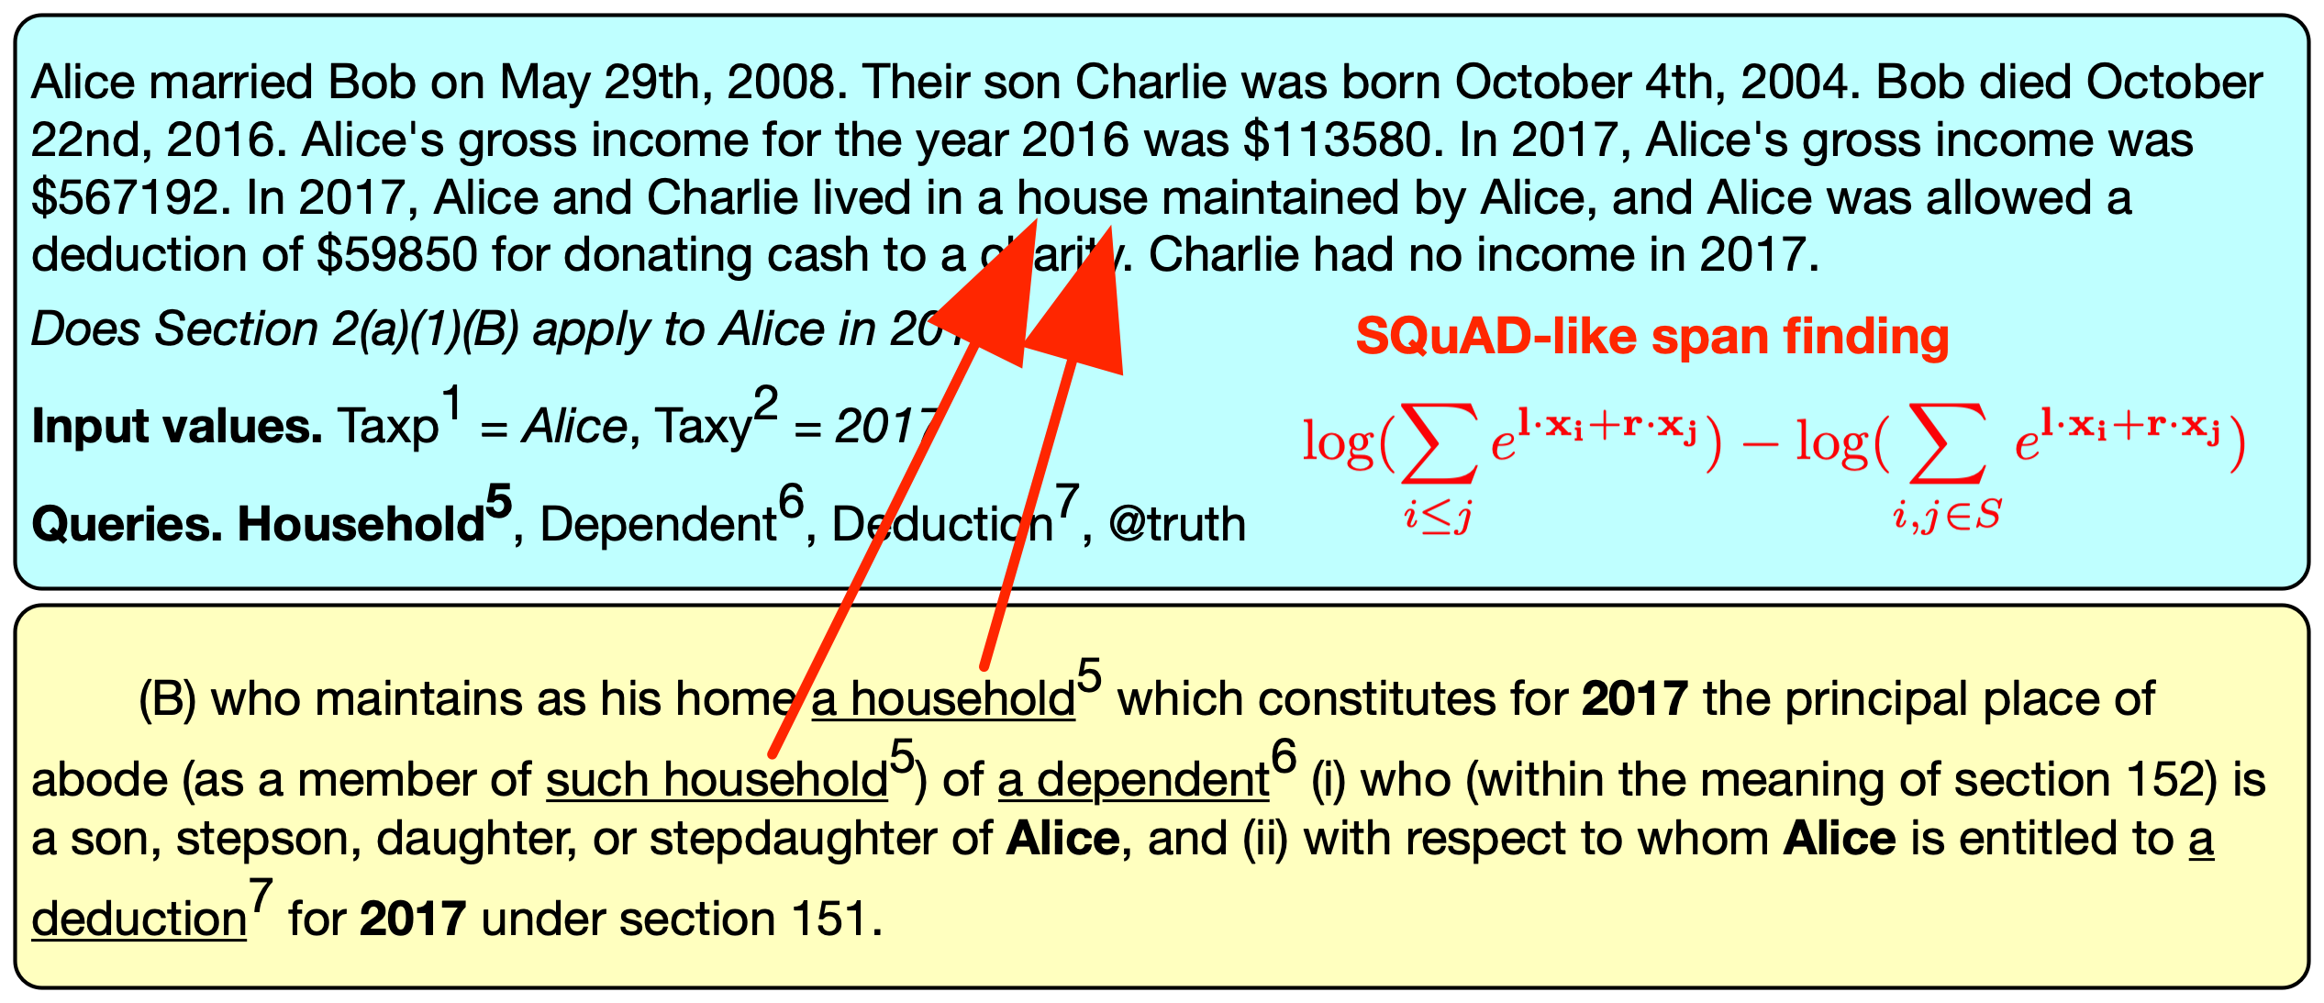
Argument instantiation — machine reading

Slide 66
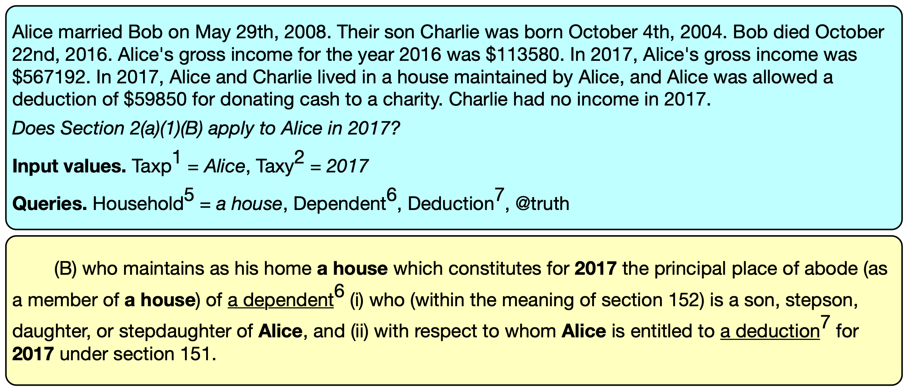
Argument instantiation — machine reading

Slide 67
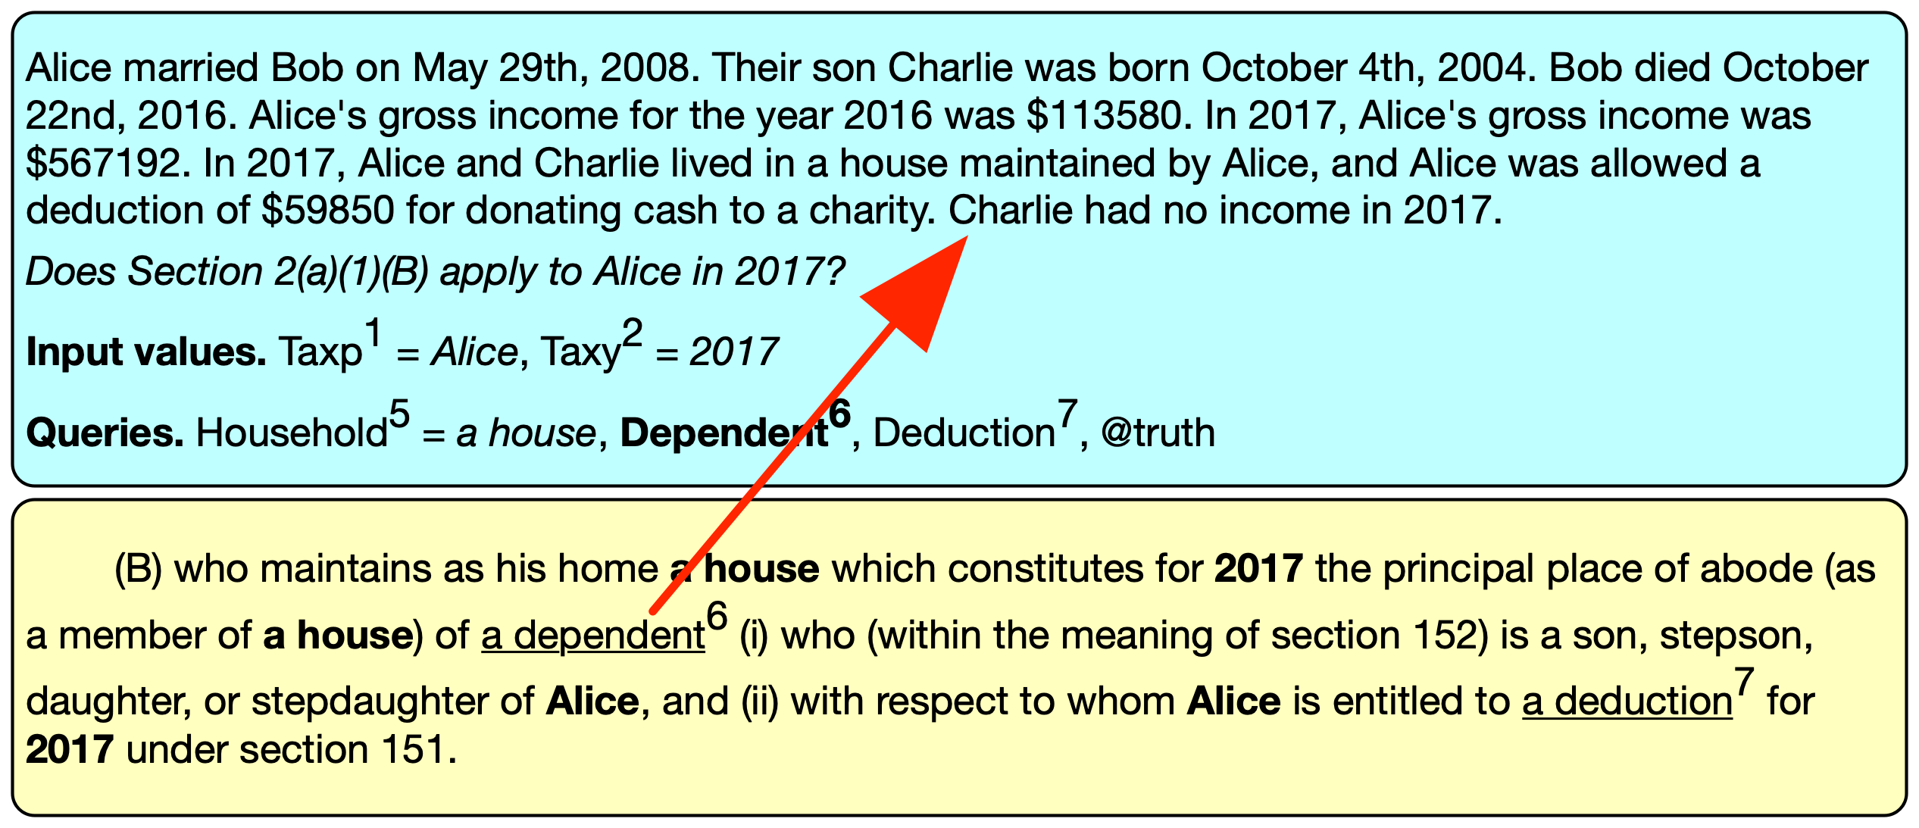
Argument instantiation — machine reading

Slide 68
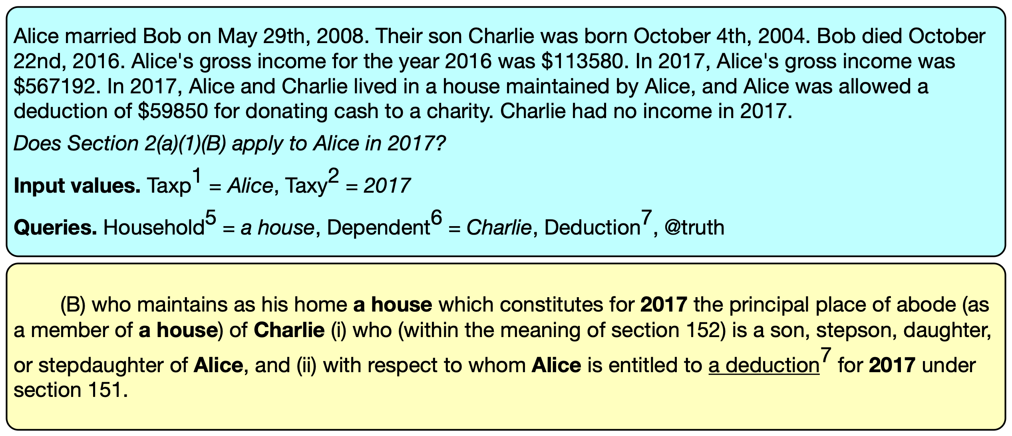
Argument instantiation — machine reading

Slide 69
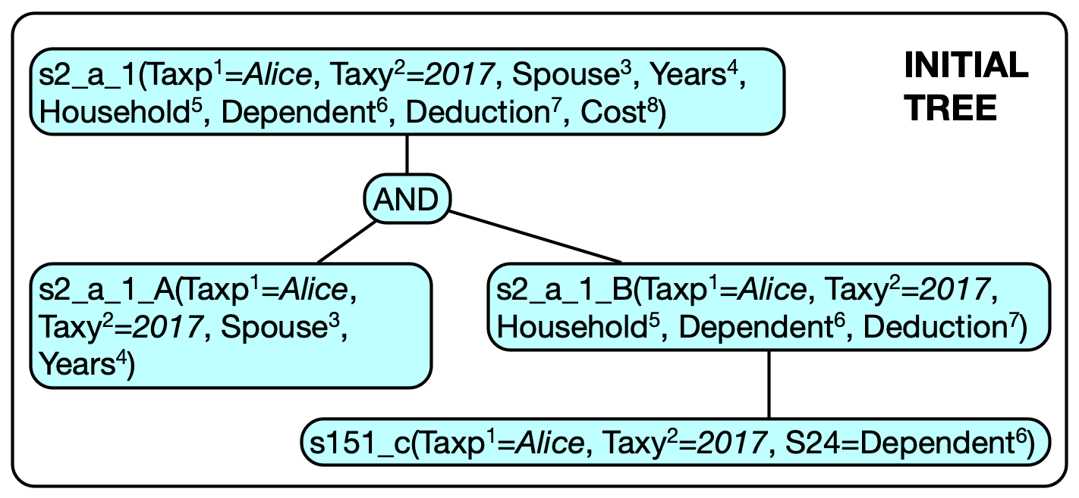
Argument instantiation — machine reading

Slide 70
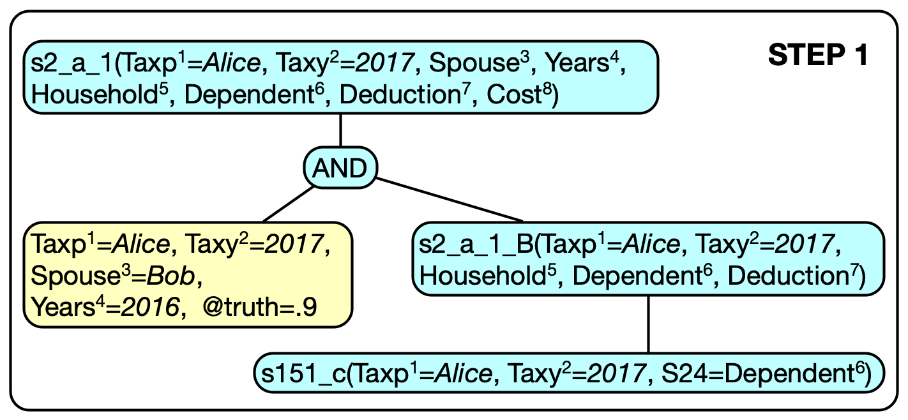
Argument instantiation — machine reading

Slide 71
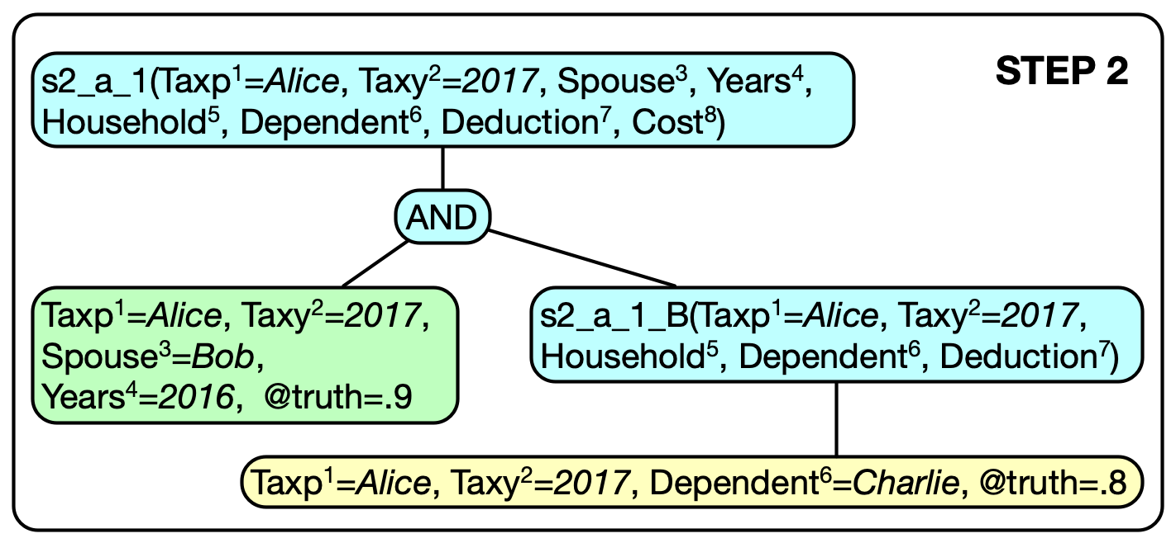
Argument instantiation — machine reading

Slide 72
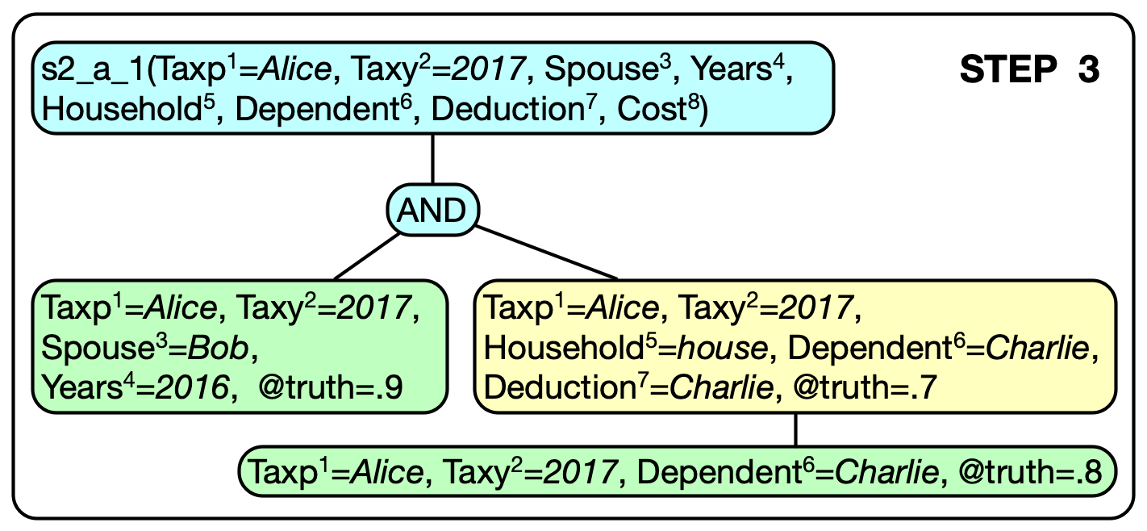
Argument instantiation — machine reading

Slide 73
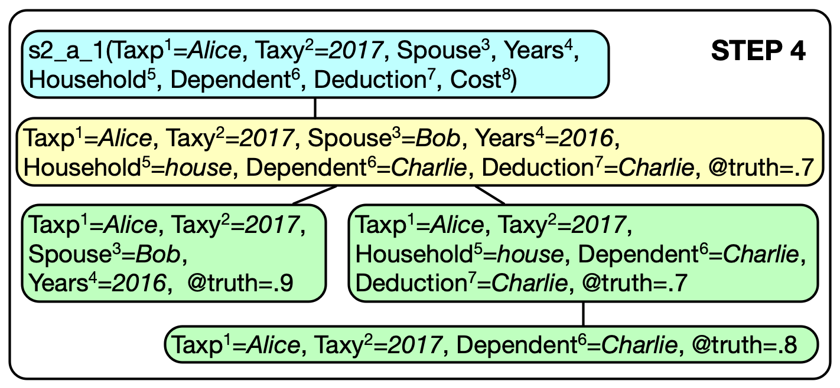
Argument instantiation — machine reading

Slide 74
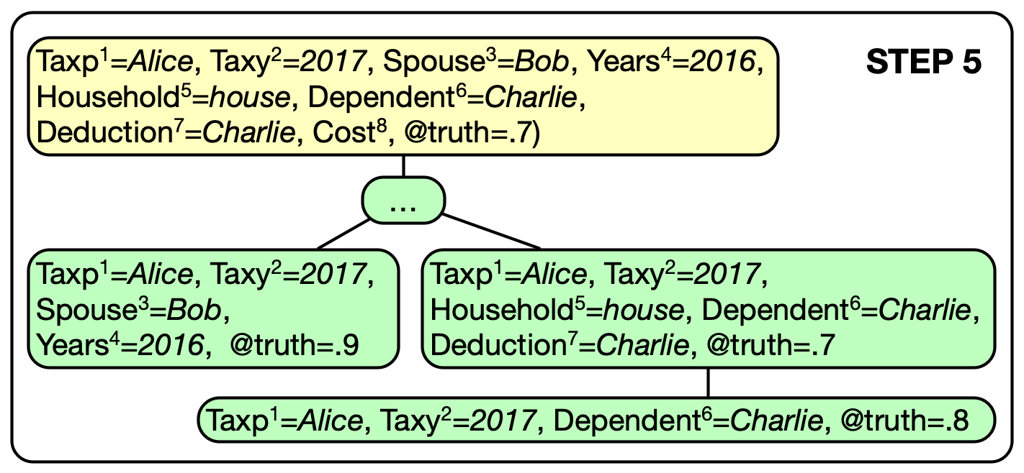
Argument instantiation — machine reading

Slide 75
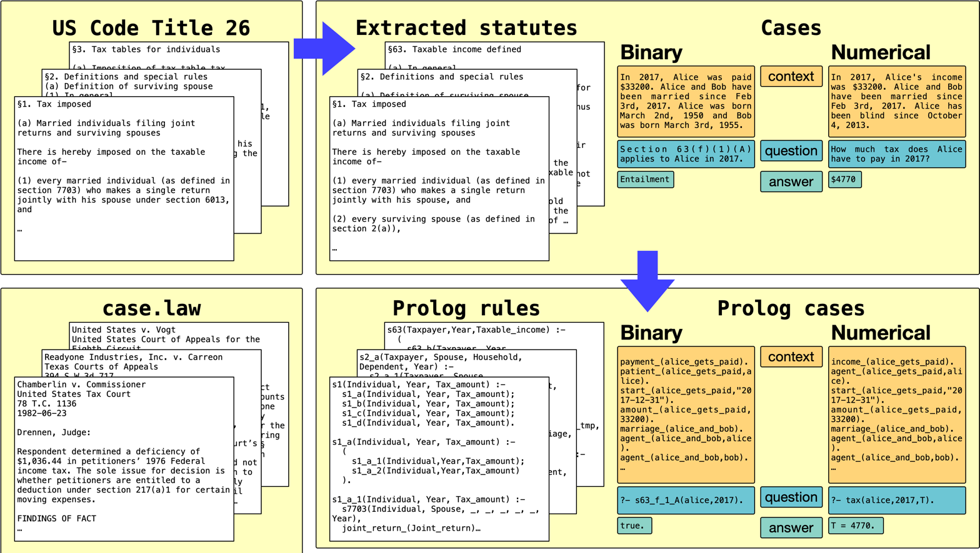
To train Neural Modules: data augmentation
Sample (case, statute) pairs from SARA, excluding text examples
Synthesize queries (For this case: does Alice owe tax? Does Bob owe tax? Does Charley owe tax…)
Prolog solver allows us to derive provides ground truth that argument aligner is trained to match

Slide 76
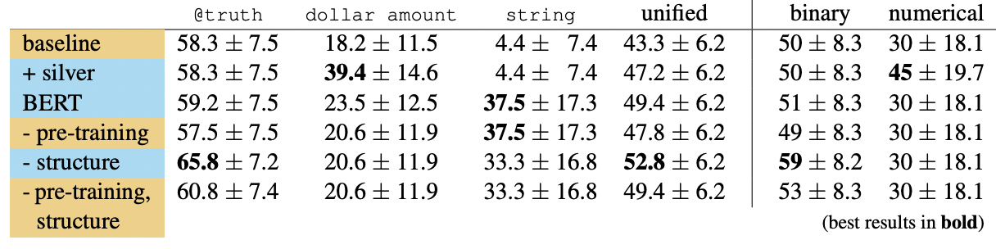
Argument Instantiation Results
Better than chance performance, data augmentation helps
But a lot left to go

Slide 77
Next steps on statutory reasoning
Dedicated solvers on subproblems, like numeric reasoning
Mapping statutes => reasoning modules through semantic parsing
Better Legal IE, improving our ability to perform argument alignment
Engaging with others interested in this challenge!

Slide 78
Questions?
Andrew Blair-Stanek
Benjamin Van Durme
Nils Holzenberger

